Slide 1


Slide 2

GEARBOX SOFTWARE Making Concept Real For Borderlands
Aaron P. Thibault VP of Product Development
Sean “Zoner” Cavanaugh Senior Rendering Engineer
SIGGRAPH
July 26 2010

Slide 3
Borderlands Timeline
Concept: April 05 –Oct 05 (up until when we shipped EIB)
Prototype: Nov 05 –Oct 06 (up until greenlit)
Development 1: Nov 06 –Aug 07 (up until Leipzig demo)
Development 2: Sep 07 –Oct 08 (Vertical Slice, E3/Leipzig demo, pre-alphas)
Final Push: Oct 08 –Oct 09 (doubled team size, art style change, story and design finalized)
2005 |  |  |  |  |  |  |  |  | 2006 |  | 2007 |  | 2008 |  | 2009
 |  |  |  |  |  |  | Concept | Prototype |  | Development 1 |  | Development 2 |  | Final Push

Slide 4
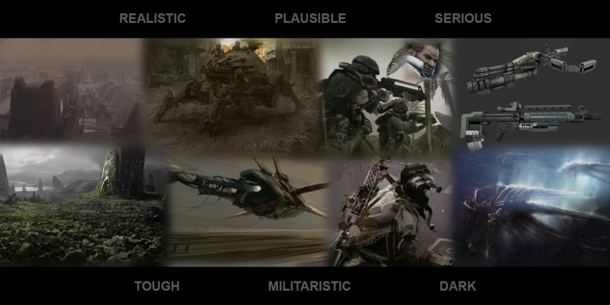
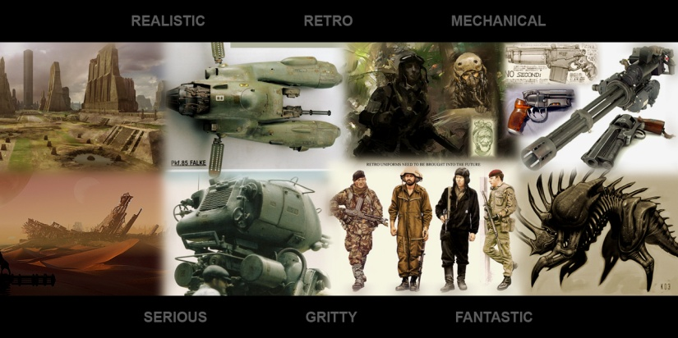
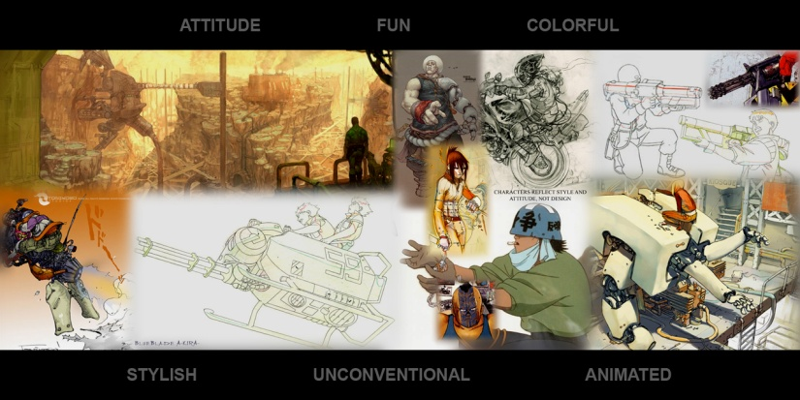
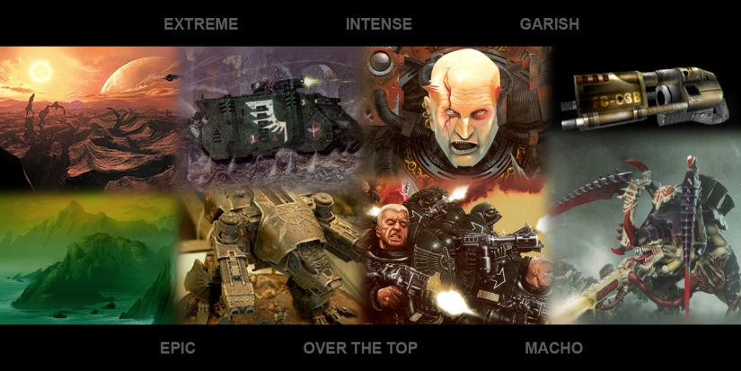
Representations on this page are trademarked by their respective owners – inclusion on this page is to represent the creative process of how Gearbox develops videogames and Gearbox in no way professes ownership of these images. All images are used under the Fair Use Doctrine of Section 107, Title 17, US Code
Concept. April 2005 – October 2005

Slide 5
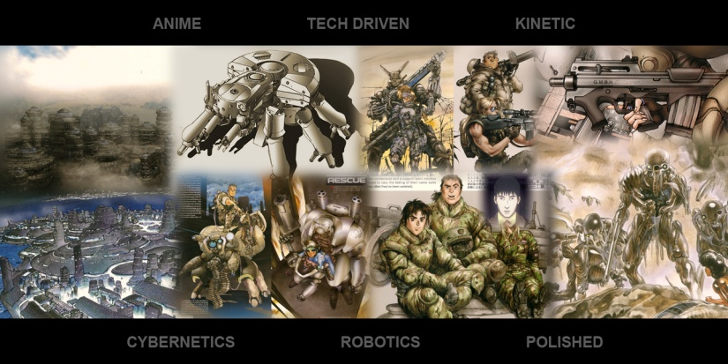
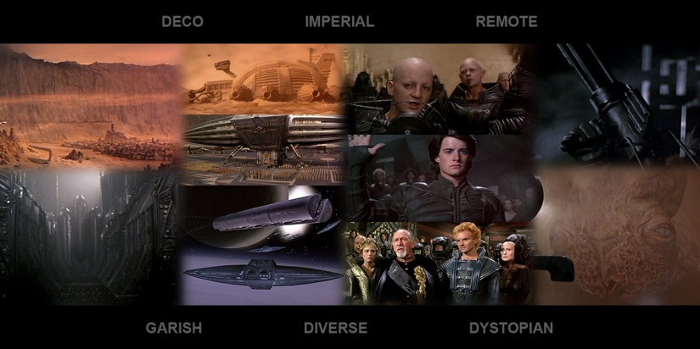
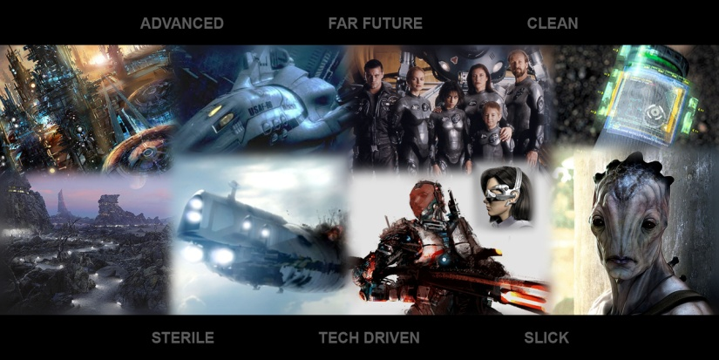
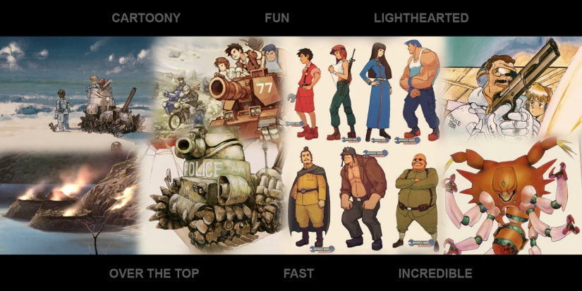
Representations on this page are trademarked by their respective owners – inclusion on this page is to represent the creative process of how Gearbox develops videogames and Gearbox in no way professes ownership of these images. All images are used under the Fair Use Doctrine of Section 107, Title 17, US Code
Concept. April 2005 – October 2005

Slide 6
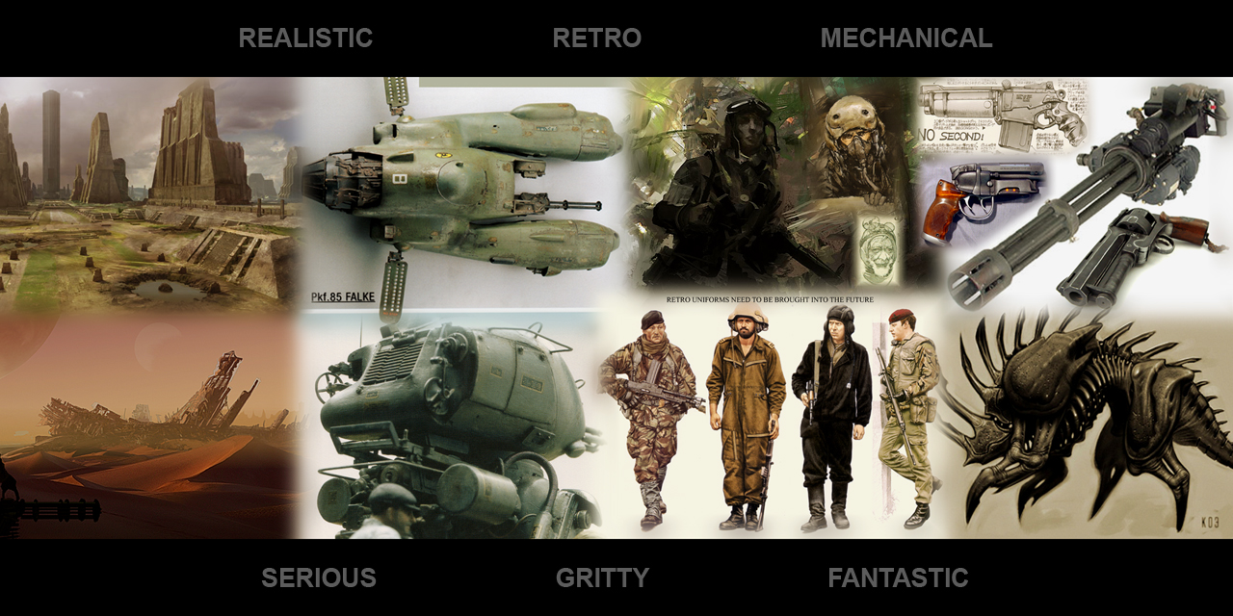
Representations on this page are trademarked by their respective owners – inclusion on this page is to represent the creative process of how Gearbox develops videogames and Gearbox in no way professes ownership of these images. All images are used under the Fair Use Doctrine of Section 107, Title 17, US Code
Concept. April 2005 – October 2005

Slide 7

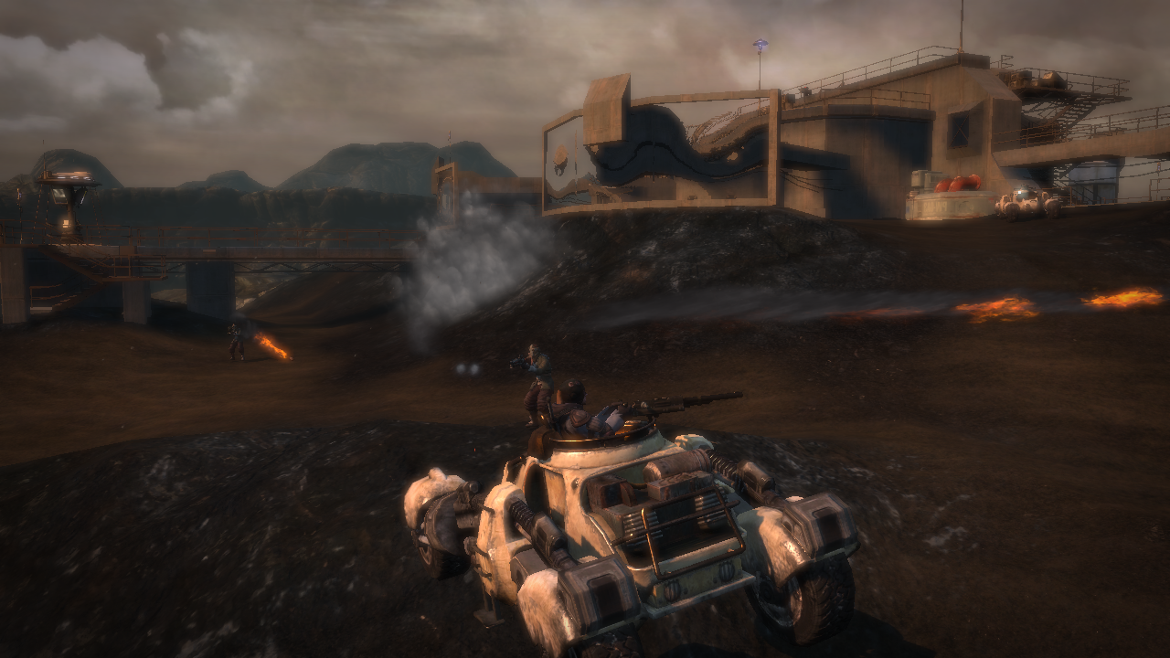
Prototype. November 2005 – October 2006
Notes:
Mad Max theme

Slide 8
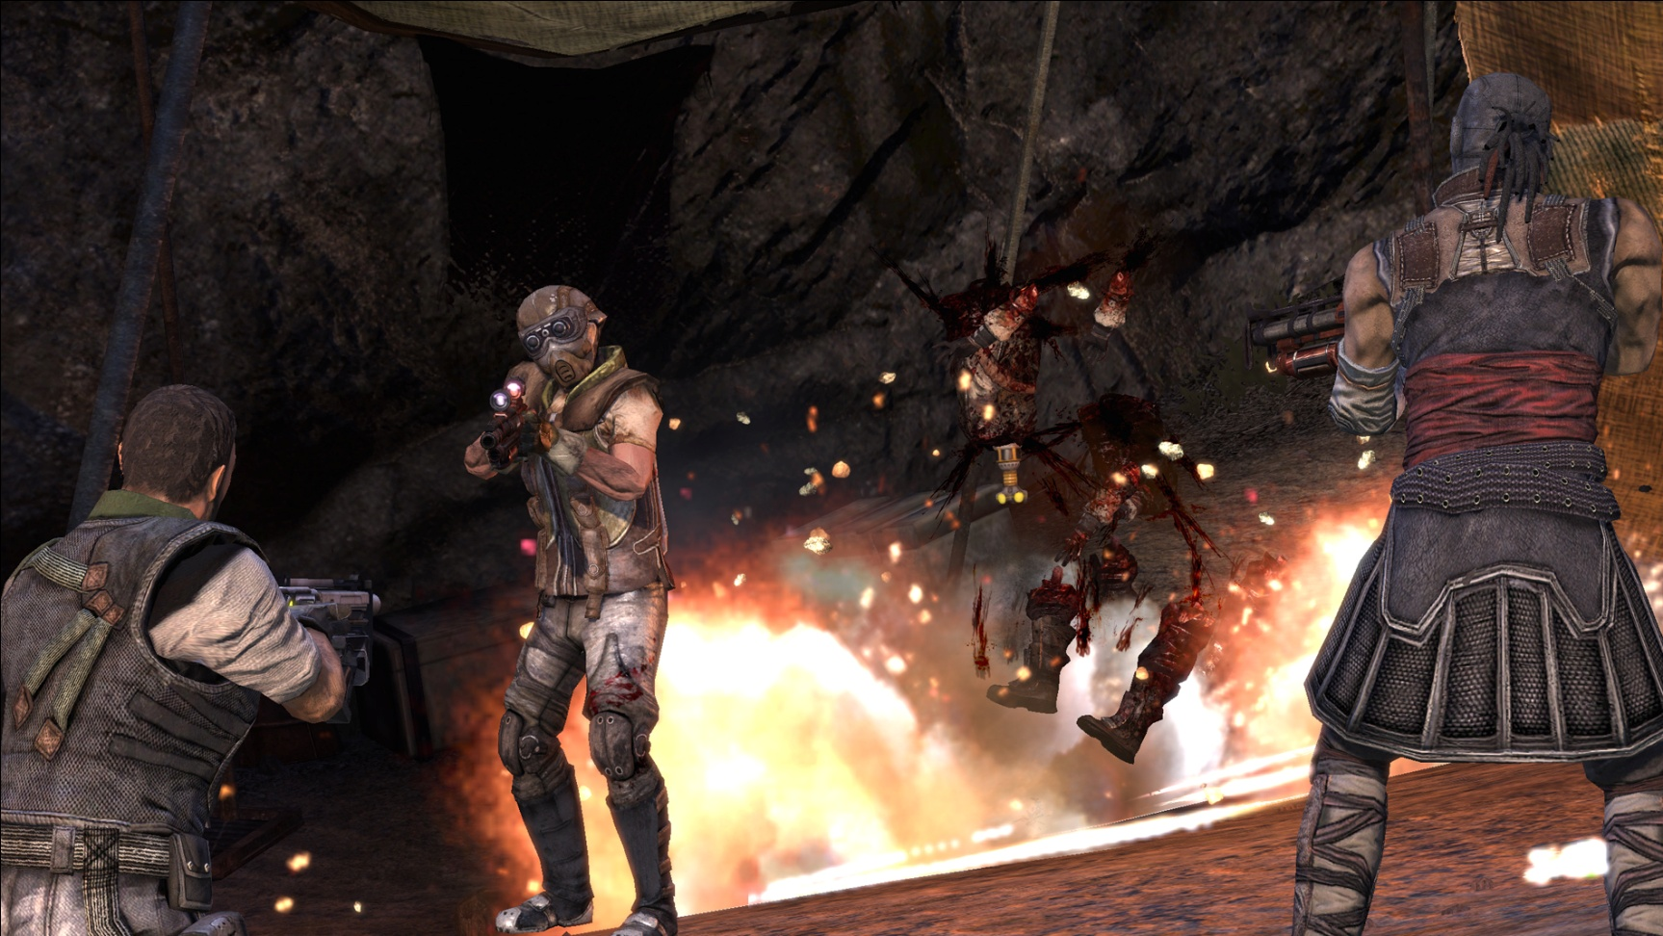
Development 1. November 2006 – August 2007

Slide 9
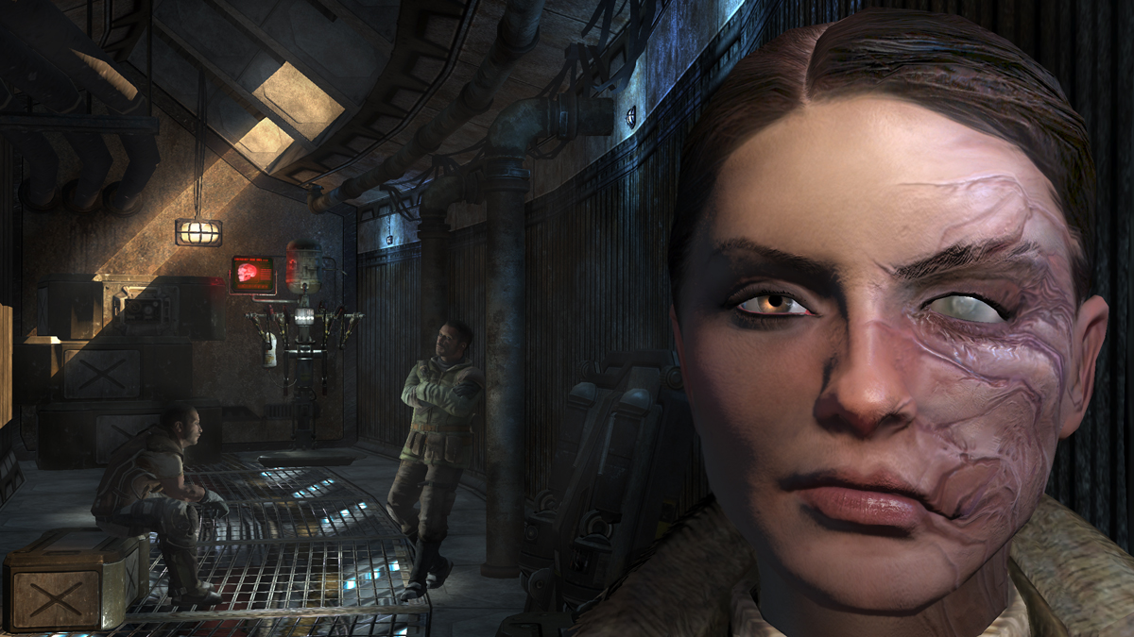
Development 2. September 2007 – October 2008

Slide 10
We Got Problems
“Photo real” style introduces possibility of constant revision
Plausible art style is at odds with over-the-top aspects of gameplay
More realistic = more detail = more time
Massive photoreal environment is expensive to produce
With so many photo-real games, how do we make Borderlands stand out?
Art Change?. November 2008

Slide 11
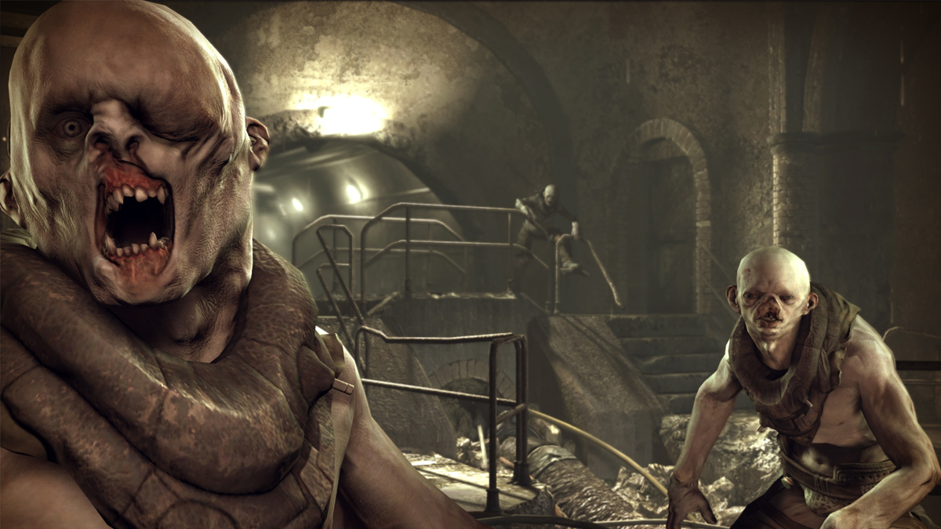
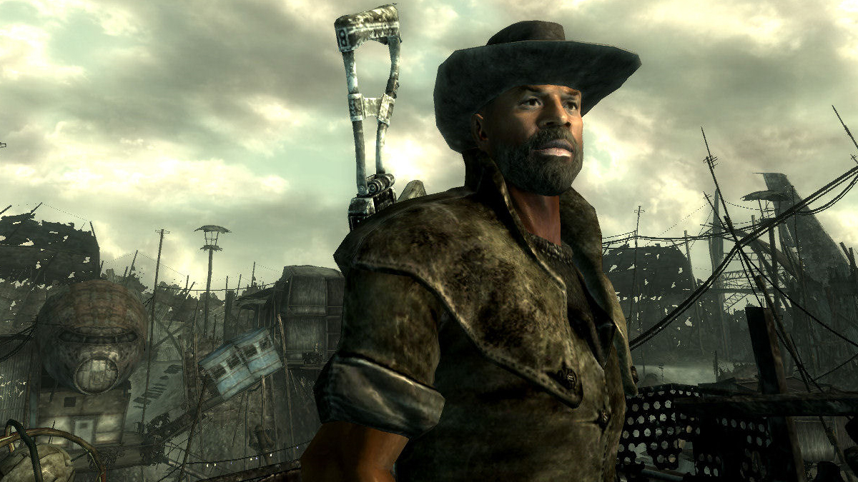
Representations on this page are trademarked by their respective owners – inclusion on this page is to represent the creative process of how Gearbox develops videogames and Gearbox in no way professes ownership of these images. All images are used under the Fair Use Doctrine of Section 107, Title 17, US Code
Competition. Rage + Fallout 3

Slide 12
How the Art Change Went Down
Prototyped behind closed doors by a group of coders and artists.
Inspired by old concept art
Initial Ideas:
“Inked” textures
Geometry Outlines
Cel Shading?
Art Changes. November 2008

Slide 13
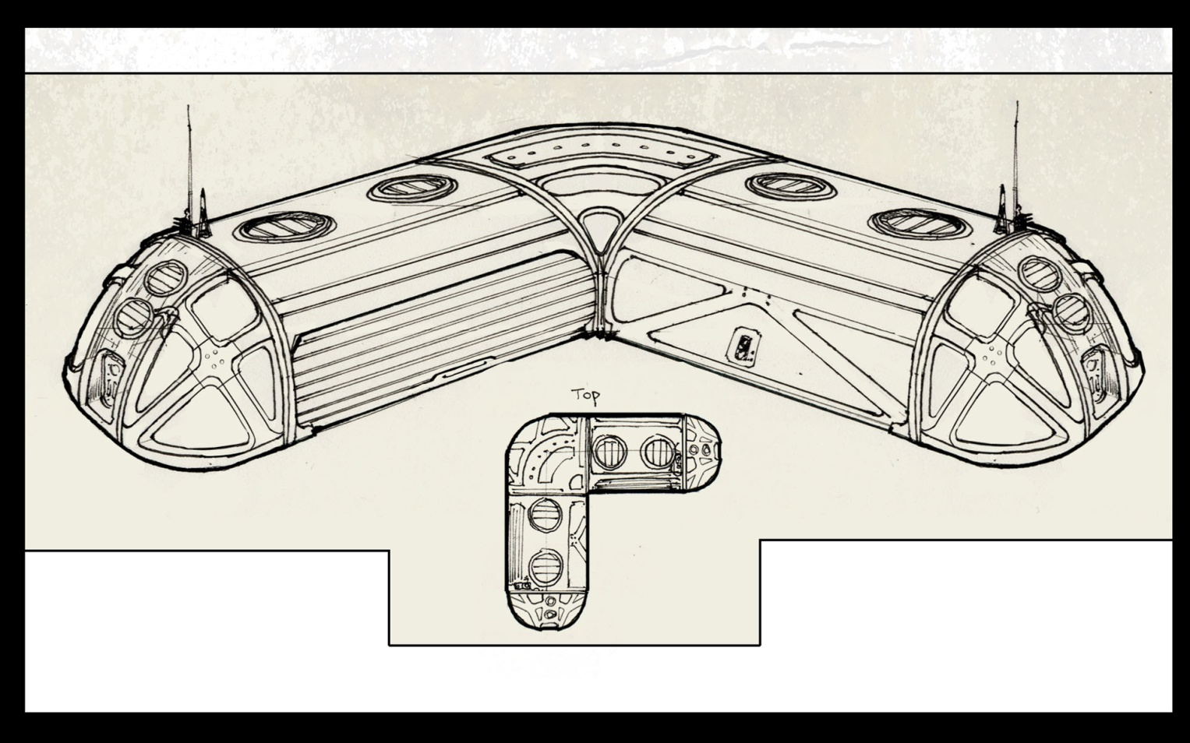
Inspiration. Old Concept Art

Slide 14
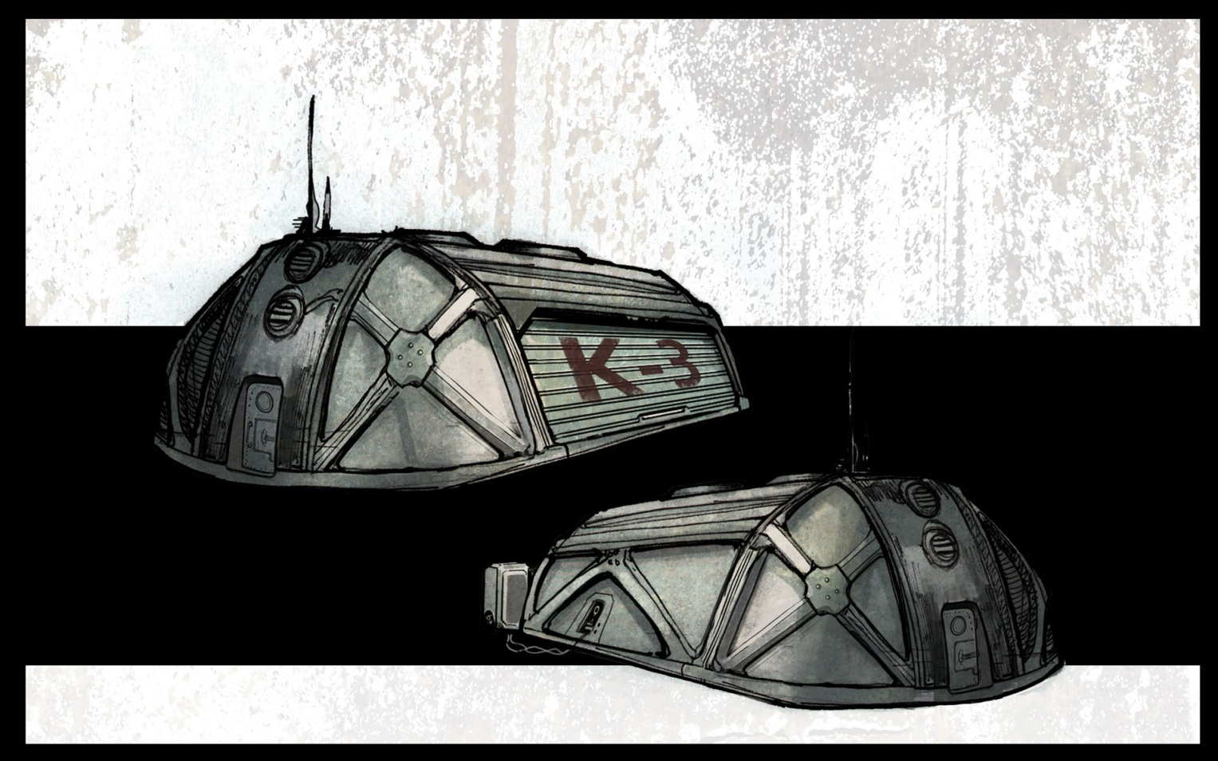
Inspiration. Old Concept Art

Slide 15
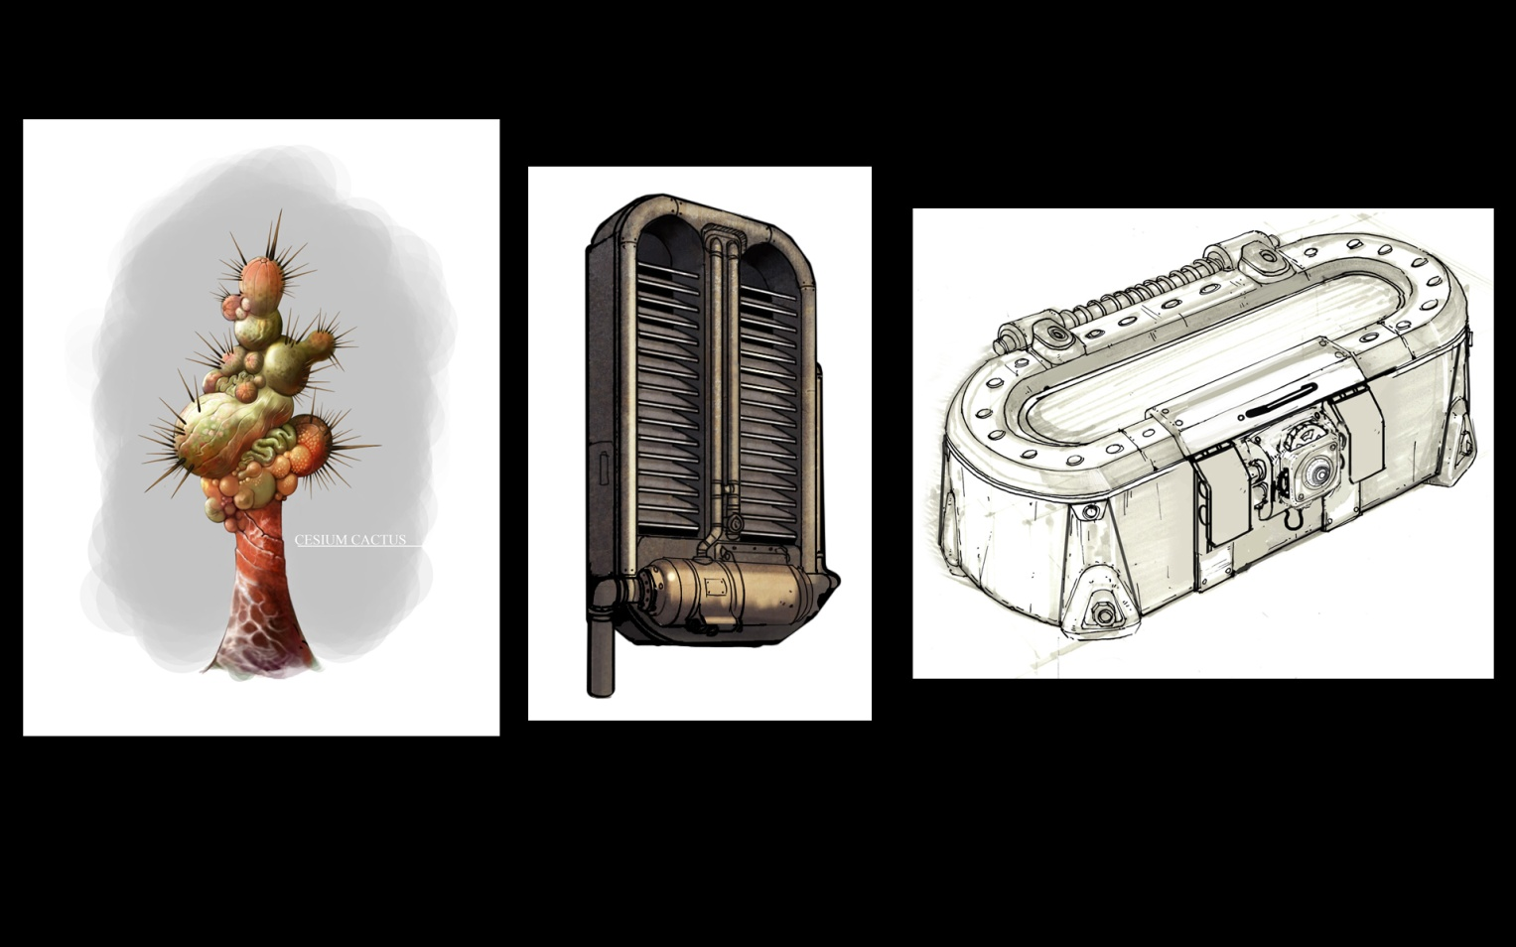
Inspiration. Old Concept Art

Slide 16
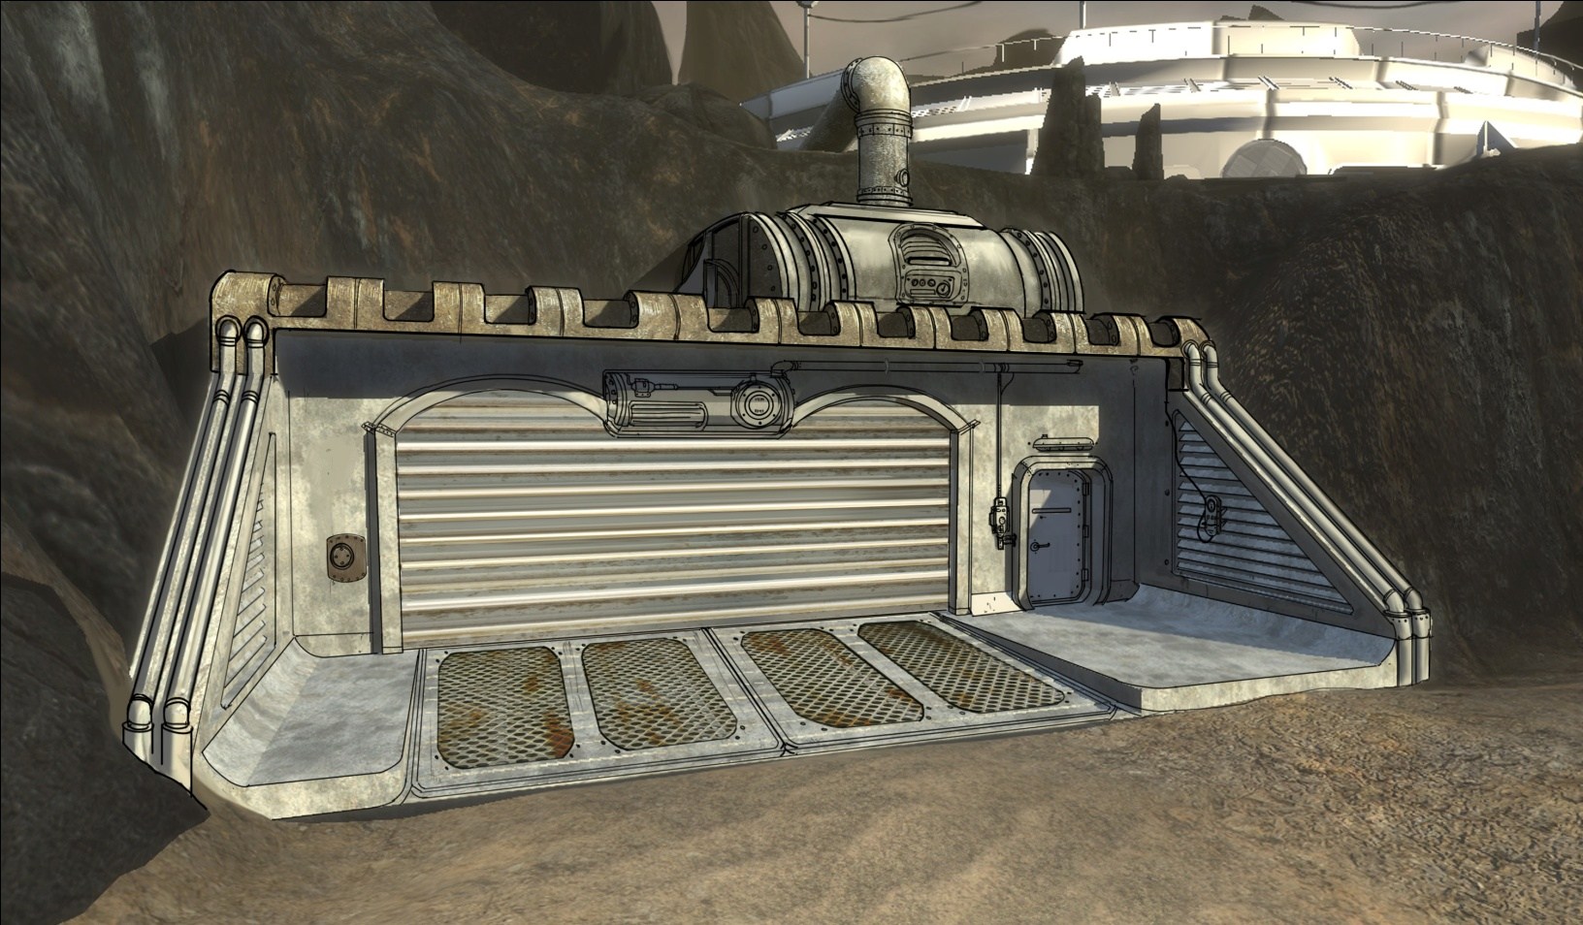
Art Change Concepts. Outlining - Artist Paintover

Slide 17
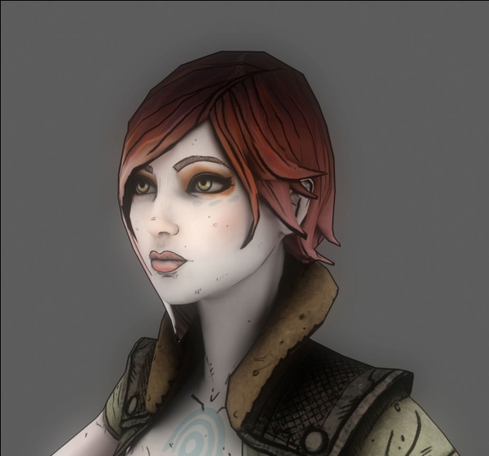
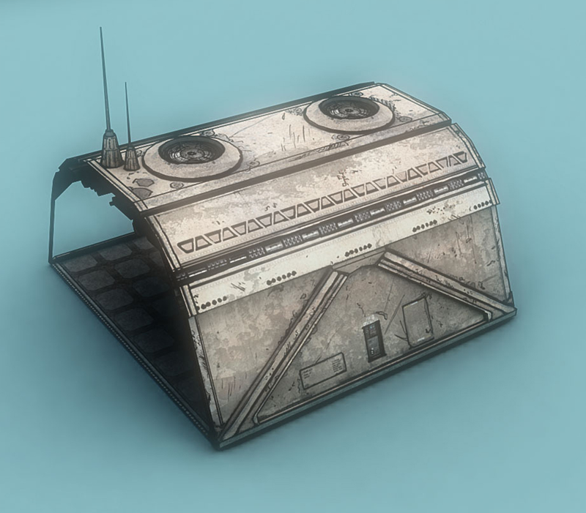

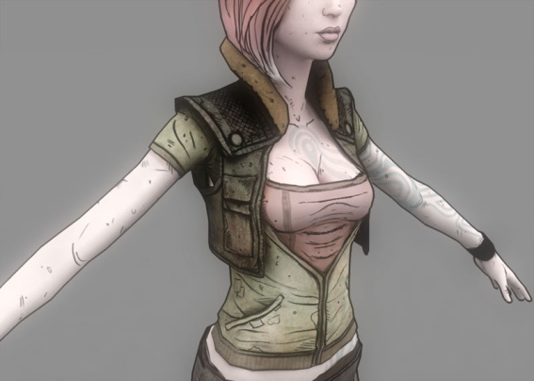
Art Change Concepts. ”Inked” assets prototyped in 3ds Max

Slide 18
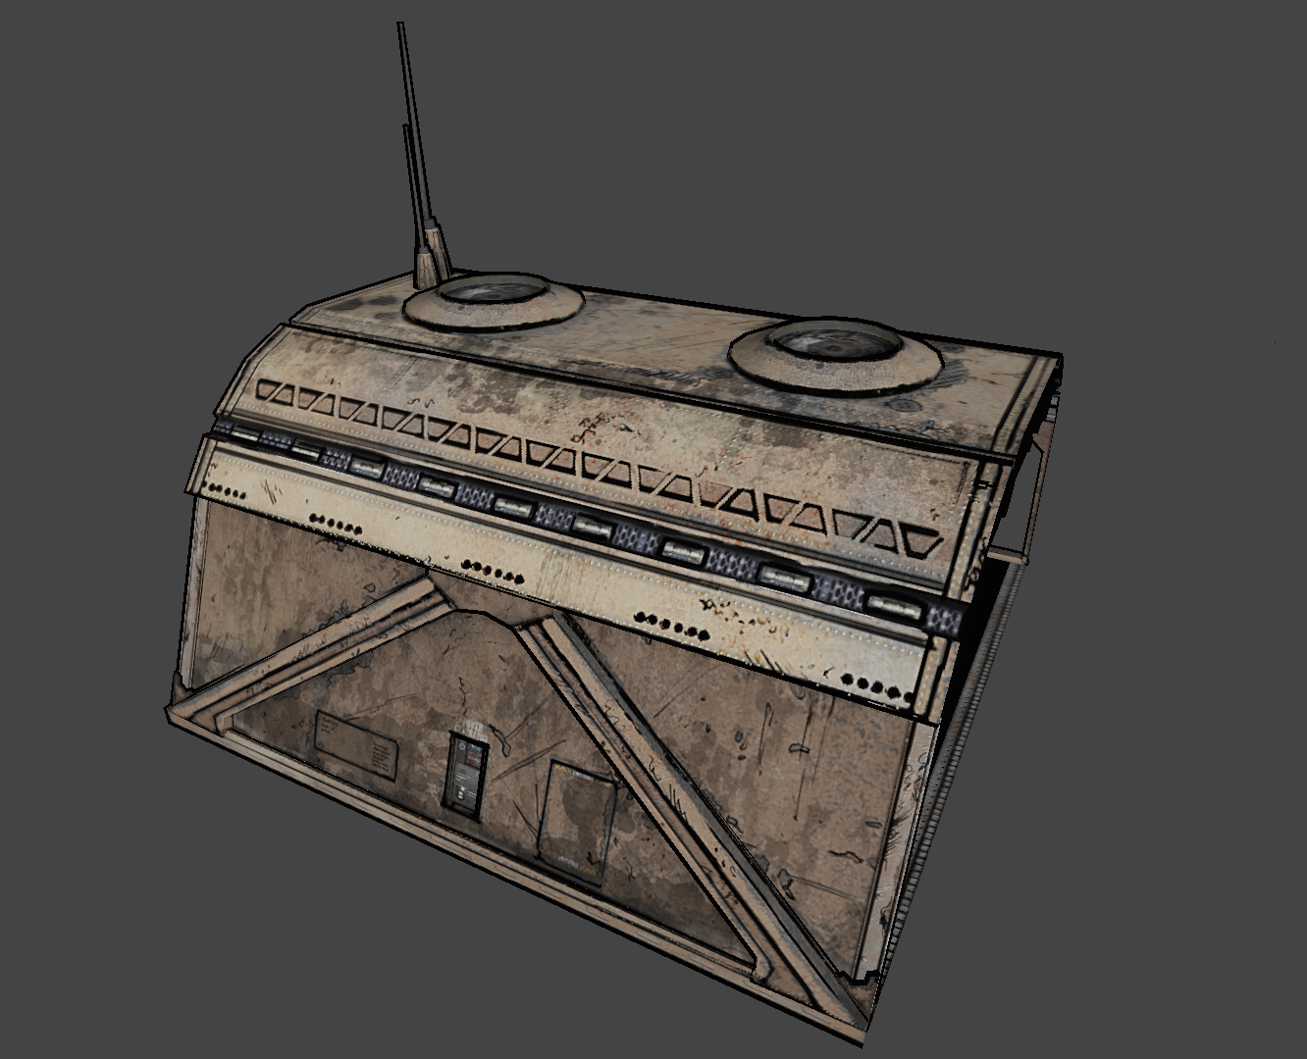
Art Change Concepts. Inverted Geometry - Artist Trickery

Slide 19
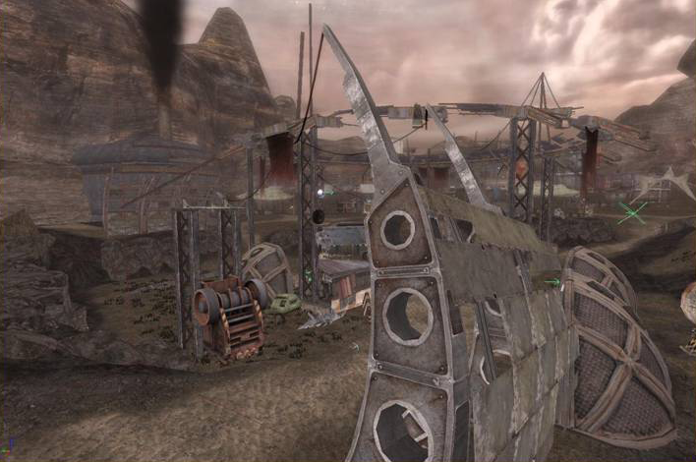
Art Change Concepts. Outlining – Coder’s Hack

Slide 20
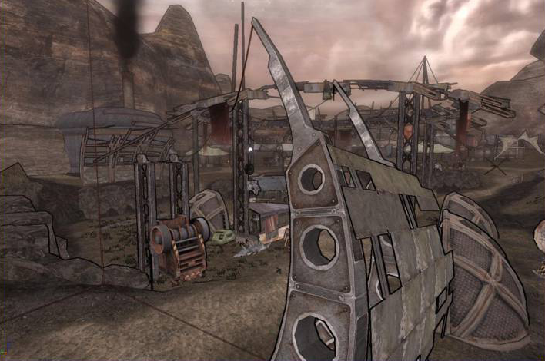
Art Change Concepts. Outlining – Coder’s Hack

Slide 21
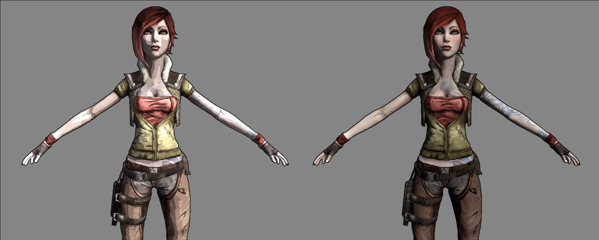
Art Change Concepts. Cel Shading – Dropped

Slide 22
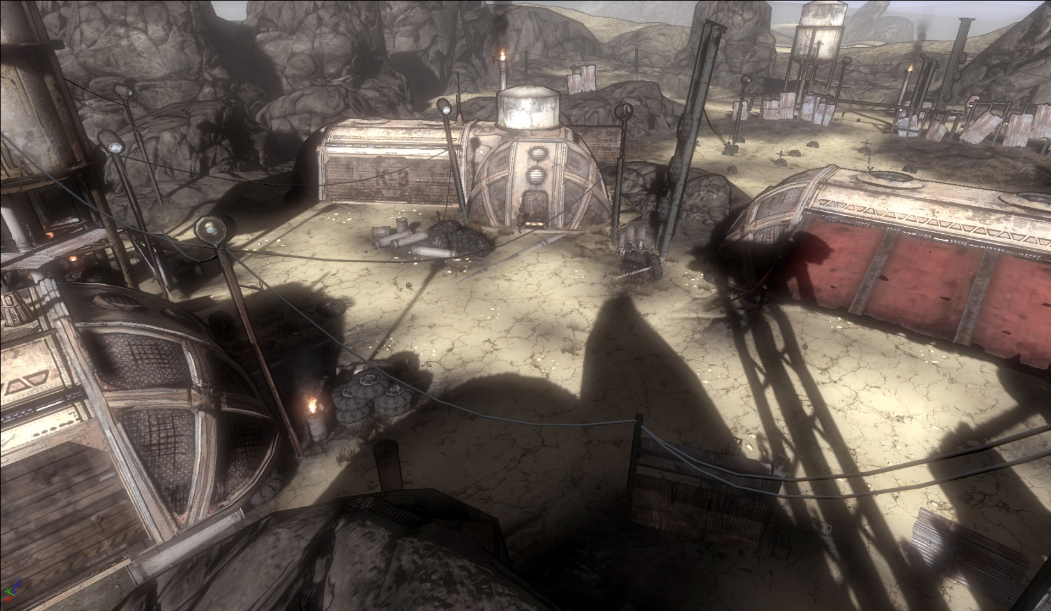
Art Prototype. Demo Area

Slide 23
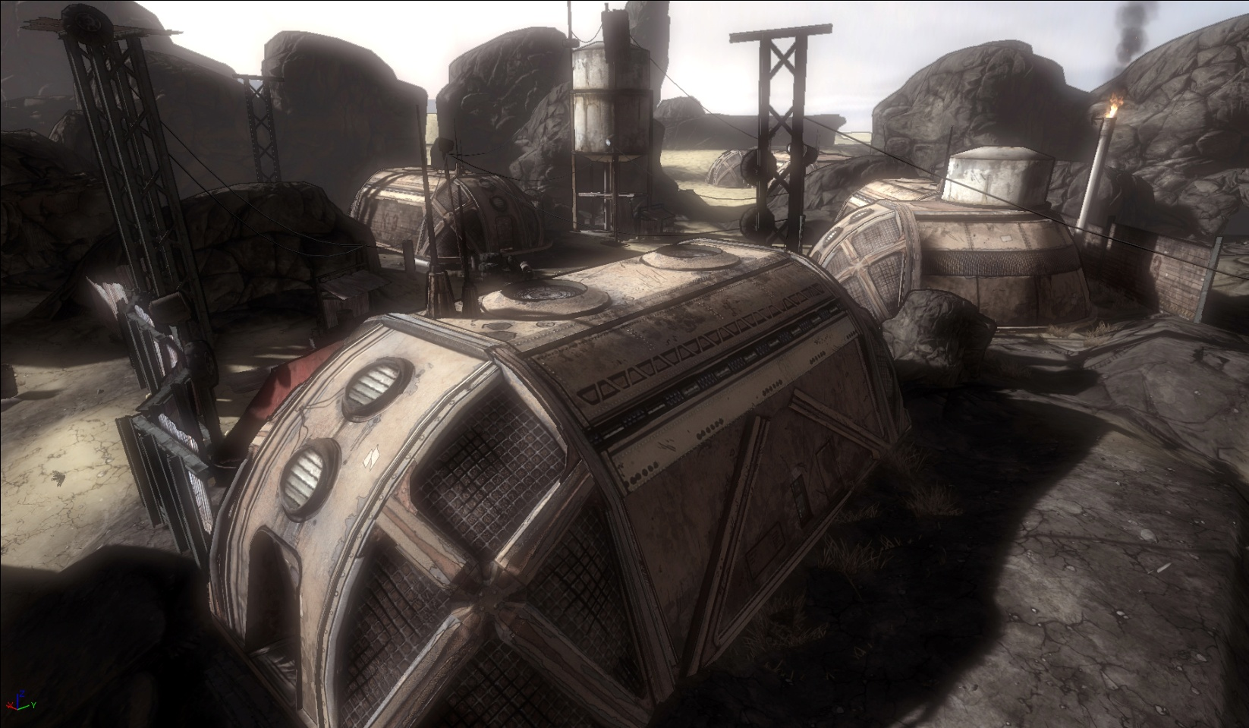
Art Prototype. Demo Area

Slide 24
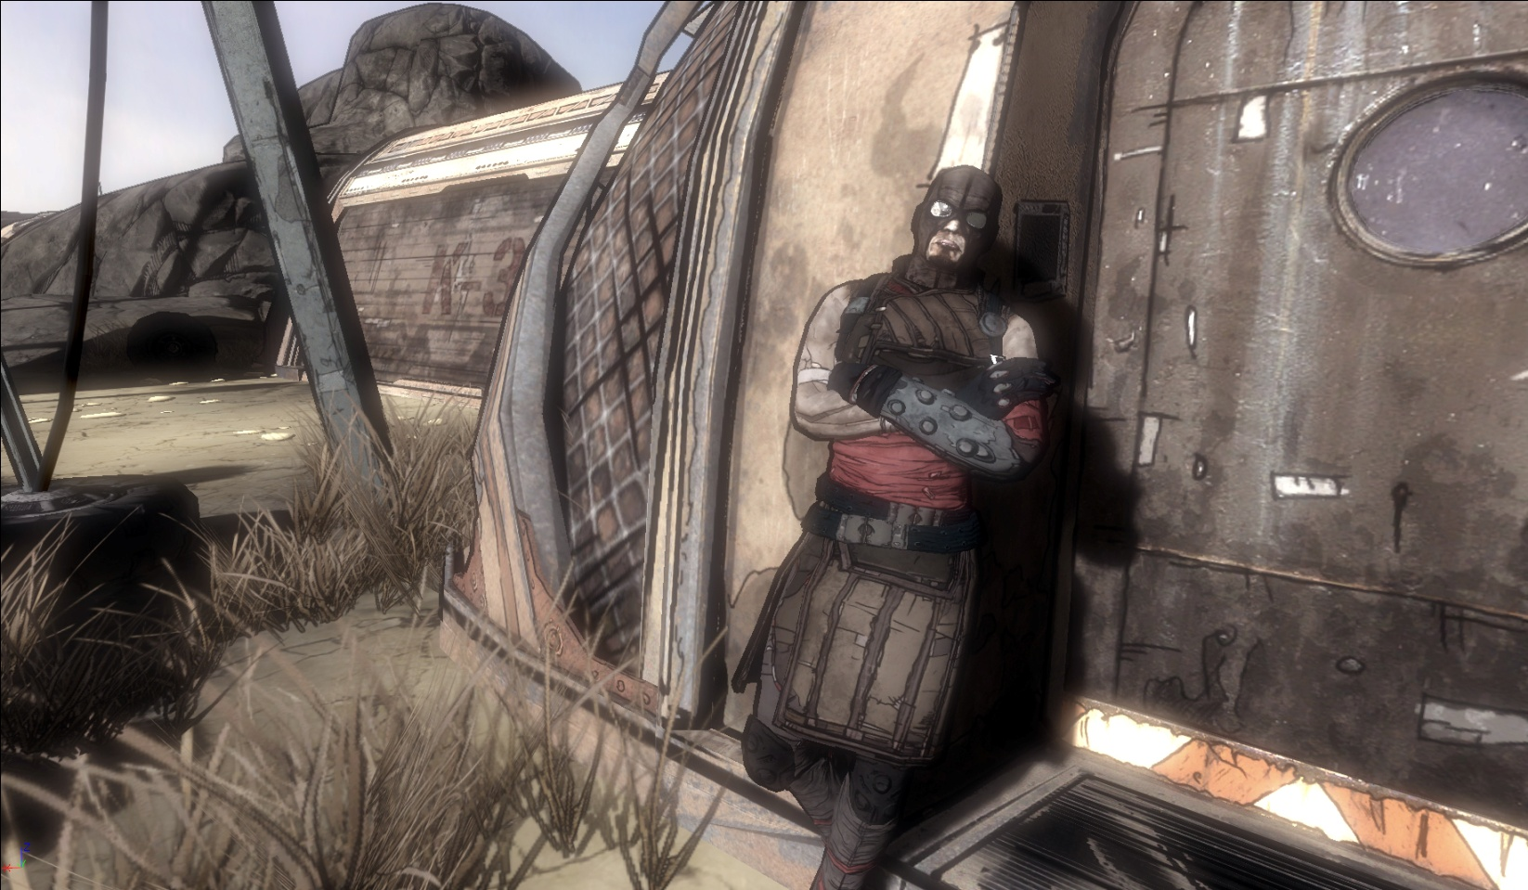
Art Prototype. Demo Area

Slide 25
Prototyping Complete!
Did a comparison with the company
Which is better?...

Slide 26
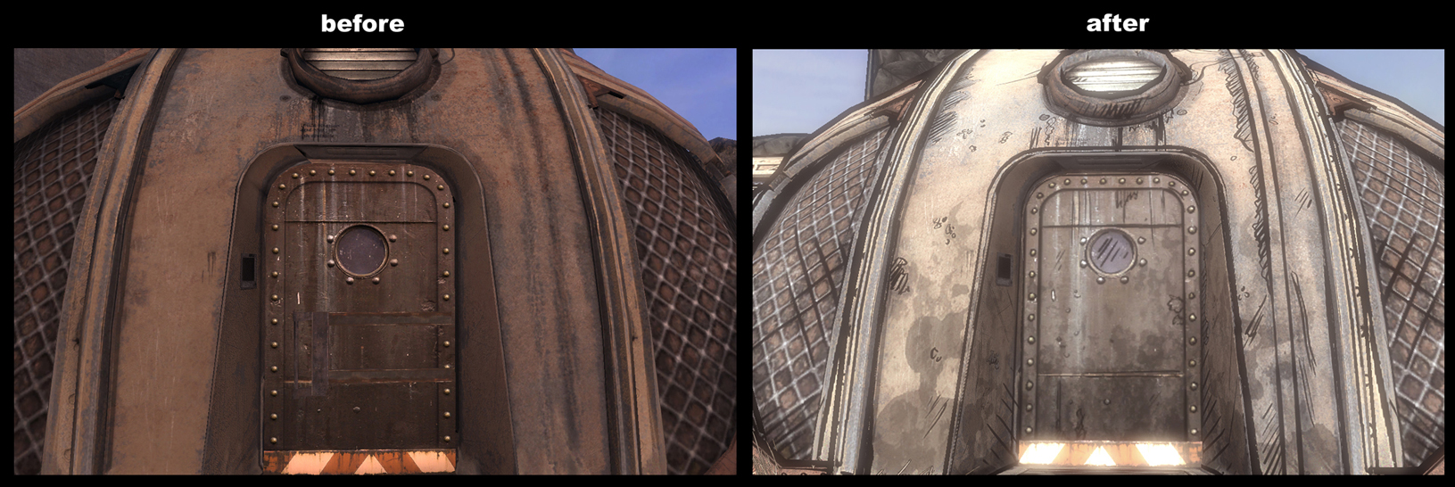
Art Change. Comparisons - 1 of 3

Slide 27
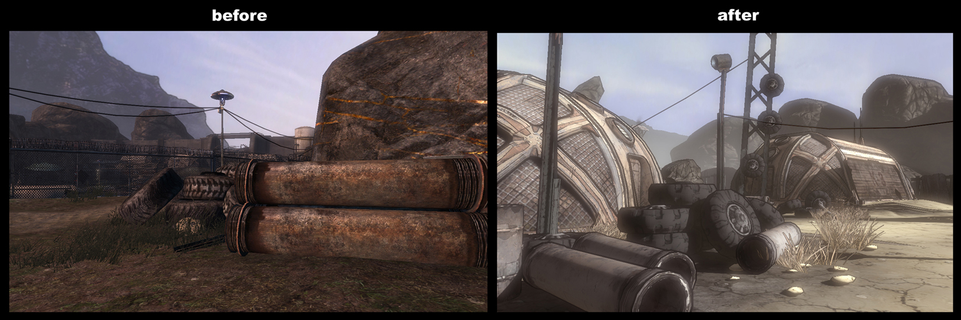
Art Change. Comparisons – 2 of 3

Slide 28
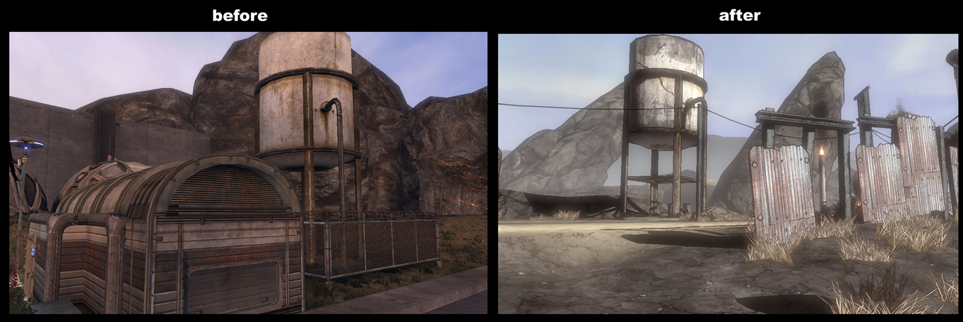
Art Change. Comparisons – 3 of 3

Slide 29
New Art Style Clearly Won

Slide 30

What did we learn from the Art Prototype?
Art
Just turning on outlines doesn’t solve problem.
All textures need to be “touched up”.
Not all photorealistic texture artists can easily switch to a “inked” style
Characters look odd. Need new proportions.
Art needs code + Code needs art

Slide 31
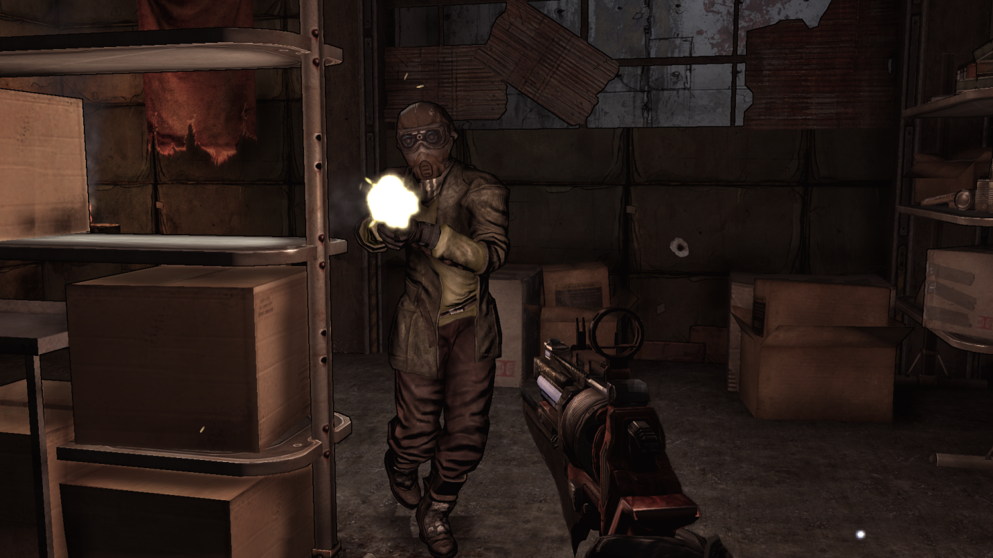
Art Process. Outlines by themselves aren’t a magic bullet!

Slide 32
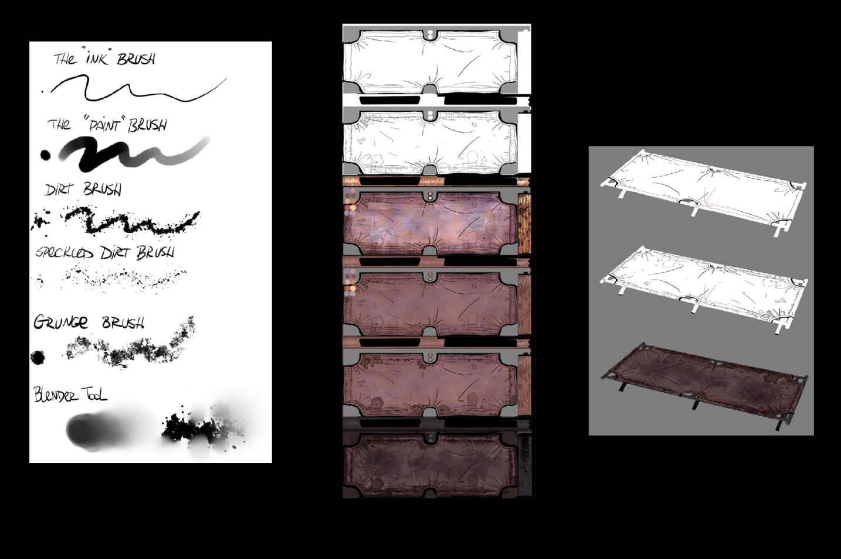
Art Process. Texture Painting Technique

Slide 33
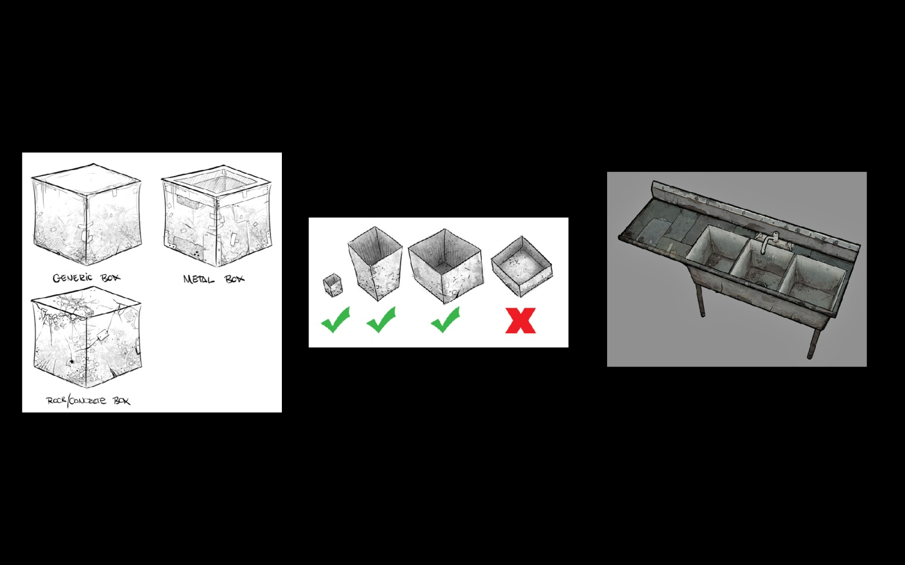
Art Process. Texture Painting Technique cont.

Slide 34
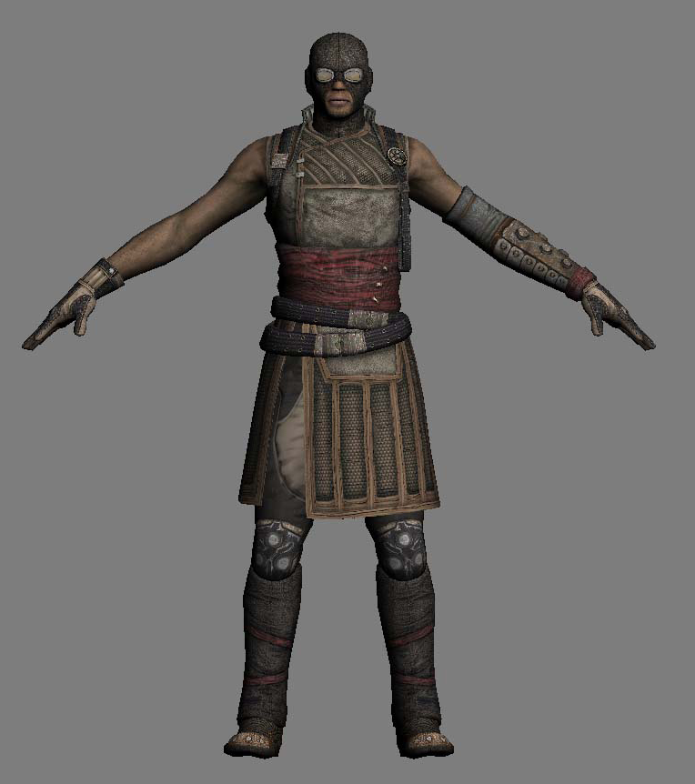
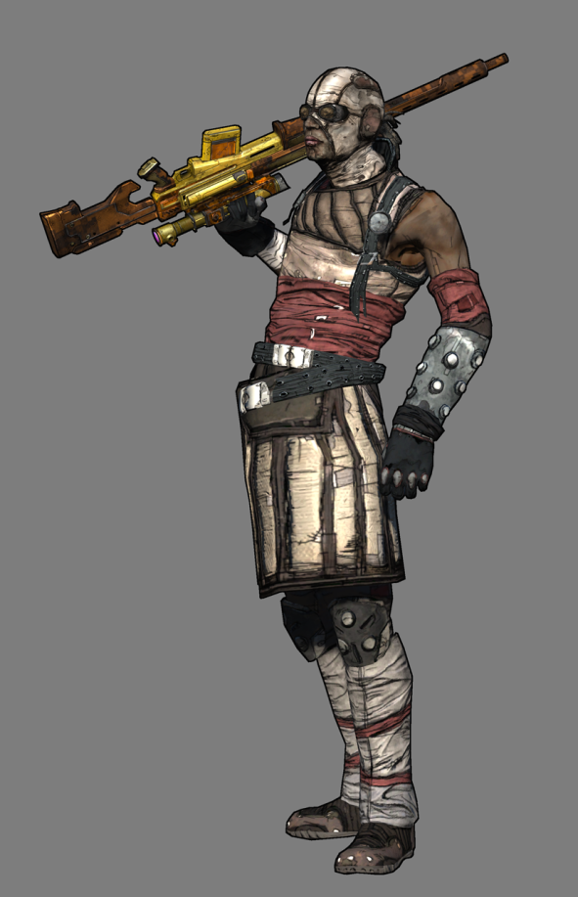
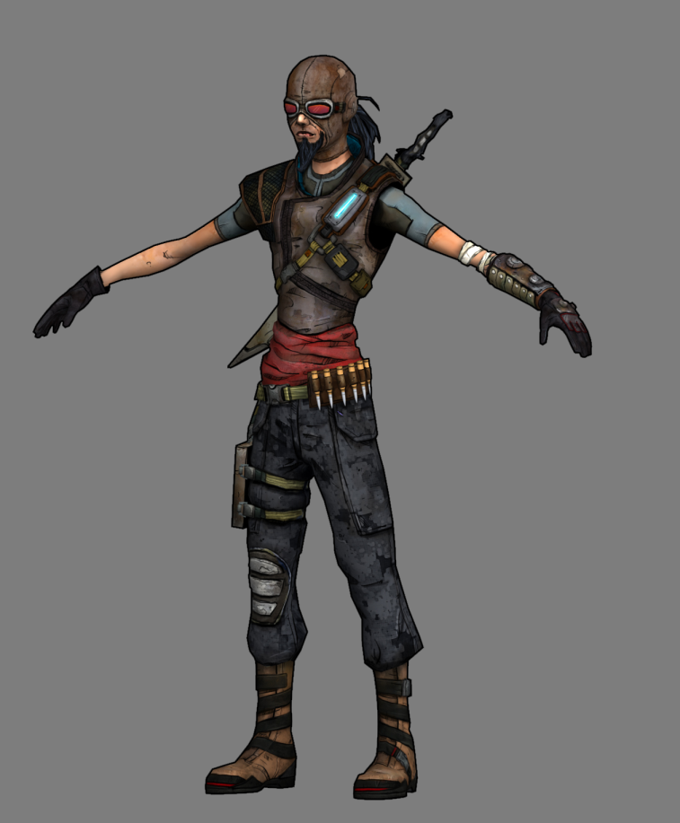
Art Process. Character Proportion/Style Changes.

Slide 35

Code Changes

Slide 36
Getting the right code
We have a mature game engine which already has it’s own pipeline
We need to add some kind of edge detection that matches the art style our artists are asking for
It needs to be fast (~3ms is our comfort zone)
We would like to inject an edge detection postprocess filter into the pipeline

Slide 37
Rendering Order
Depth only pre pass
Cascade shadowmap passes for directional light
Opaque color pass with shadowed directional light
Extract edge detection (for world)
Possible opaque dynamic lighting passes
Extract edge detection (for weapon)
Rendering. Pipeline Order – 1 of 2

Slide 38
Rendering Order (cont.)
Apply edge detection
Translucent objects
Fog
Distortion
Depth of Field & Bloom
Rendering. Pipeline Order – 2 of 2

Slide 39
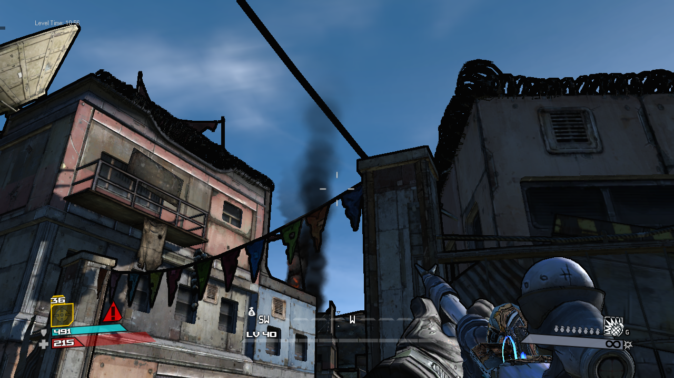
Black Outlines. Post Process Edge Problems

Slide 40
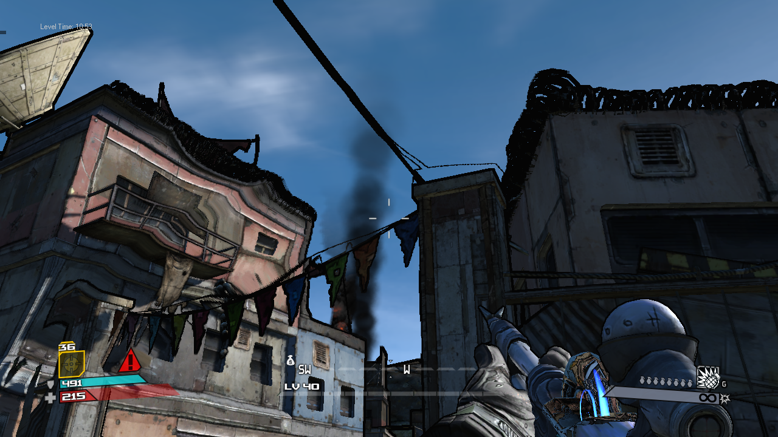
Black Outlines. Post Process Edge Problems

Slide 41
Pipeline Woes
The player’s weapon is rendered with a much lower field of view than the world
The weapon must draw on top of everything
The shadows for the weapon must be calculated at the same time as the world because we have to recycle the memory the render targets occupy
Rendering. Woes – 1 of 2

Slide 42
Platform Woes
X360 - Edges read Z-buffer on X360
X360 – Edges rendered directly into frame buffer
PC & PS3 – Edges rendered to render target and saved for later due to pipeline dependencies on the correct depth values
PC and PS3 – Edges read FP16 alpha channel from frame buffer
Rendering. Woes – 2 of 2

Slide 43

First Implementation
Proof of concept
Rendered the models twice with offset and a second shader
Black Outlines. Stages of Implementation

Slide 44
Second Implementation
Fast but not final
Cross Filter (4 texture fetches)
Gave us enough confidence to iterate it one more time
Black Outlines. Stages of Implementation

Slide 45
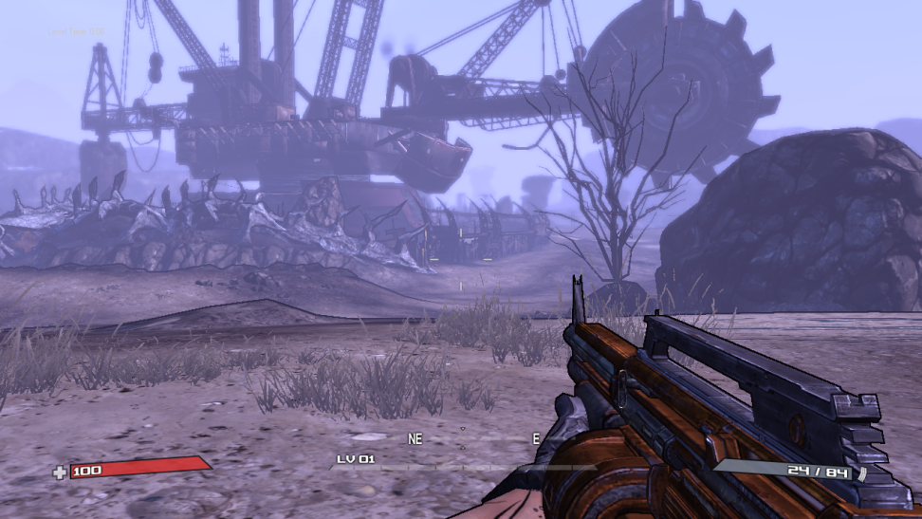
Third Implementation
Sobel Filter (9 texture fetches)
Slower but everyone was willing to pay for it
It works until it breaks
Required several iterations
Black Outlines. Stages of Implementation

Slide 46
Sobel Filter
Fetch 3x3 Block of Texels
4 Coefficients, 1 Power
Two Filters working together:
Vertical Filter
[A B A]
[0 0 0]
[-A –B –A]
Horizontal Filter
[C 0 -C]
[D 0 -D]
[C 0 –C]
Black Outlines. Sobel Filter

Slide 47
Sobel Equation
Texels do not need to be touching
Texel offset decided by artist
Filter is resolution dependant
Impossible to make fully resolution independent
Smallest kernel is 1 texel
Large kernel sizes generate noise, halos, and thrash the texture cache
Black Outlines. Sobel Filter

Slide 48
Sobel Shader Pseudocode
// Our Depth is W not Z
float CenterDepth = GetCenterDepth( CenterUV );
float4 DepthsDiag = GetDiagDepths( DiagTexelUVs[] );
float4 DepthsAxis = GetAxisDepths( AxisTexelUvs[] );
DepthsDiag -= CenterDepth; // Treat our local depth as 0
DepthsAxis /= CenterDepth; // Use relative depth instead of absolute
float4 SobelH = DepthsDiag * HorizDiagCoeff + DepthsAxis * HorizAxisCoeff;
float4 SobelV = DepthsDiag * VertDiagCoeff + DepthsAxis * VertAxisCoeff;
float SobelX = dot(SobelH, float4(1,1,1,1));
float SobelY = dot(SobelV, float4(1,1,1,1));
float Sobel = sqrt(SobelX * SobelX + SobelY * SobelY);
float Color = saturate(1 – pow(saturate(Sobel), SobelPower);
Black Outlines. Sobel Filter
Notes:
HorizDiagCoeff , HorizAxisCoeff, VertDiagCoeff , VertAxisCoeff are packed shader constant copies of the 4 main sobel coefficients, so the shader can parallelize as much of the math as possible

Slide 49
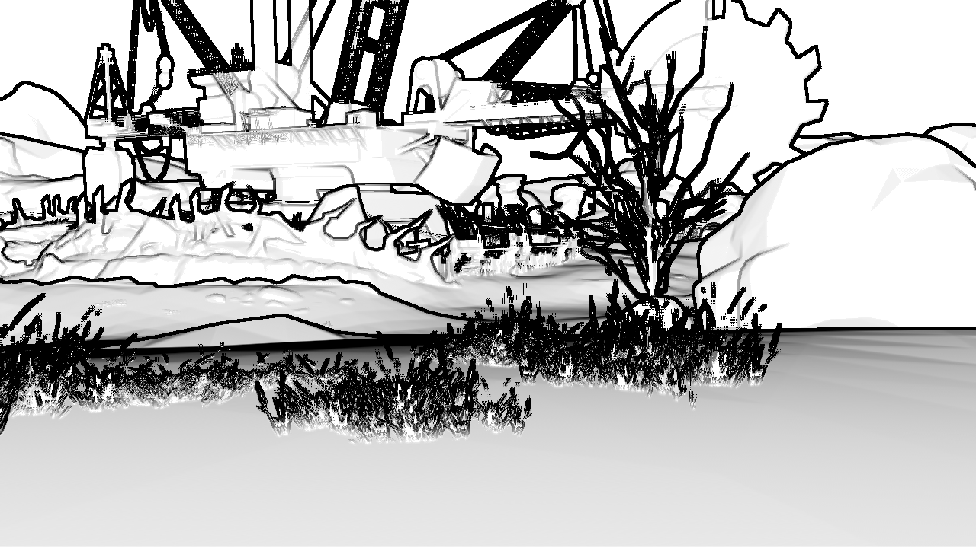
Black Outlines. Naive Sobel Filter – Raw Filter

Slide 50
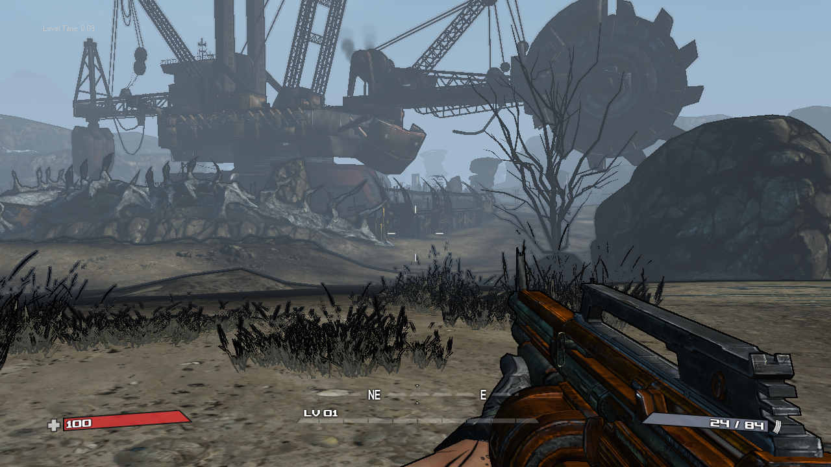
Black Outlines. Naive Sobel Filter - Composite

Slide 51
Naive Sobel Filter
Good News:
The filter works
Bad News:
It’s ugly, and needs more tweaking
Edges are computed on both sides of the edge
Noisy depth information generates noise
Every other post process breaks due with the depth and the color being incoherent (Fog, Depth of Field, Bloom, Distortion)
Black Outlines. Sobel Filter

Slide 52
Improved Sobel Shader Pseudocode
// Our Depth is W not Z
float CenterDepth = GetCenterDepth( CenterUV );
float4 DepthsDiag = GetDiagDepths( DiagTexelUVs[] );
float4 DepthsAxis = GetAxisDepths( AxisTexelUvs[] );
// Discard exterior edge texels
// Reversing the test gets the other side if you want it...
DepthsDiag = (DepthsDiag > CenterDepth.xxxx) ? DepthsDiag : CenterDepth.xxxx;
DepthsAxis = (DepthsAxis > CenterDepth.xxxx) ? DepthsAxis : CenterDepth.xxxx;
DepthsDiag -= CenterDepth.xxxx;
DepthsAxis /= CenterDepth.xxxx;
// Same code as previous slide follows etc . . .

Slide 53
Black Outlines. Naïve Sobel Filter – Raw Filter

Slide 54
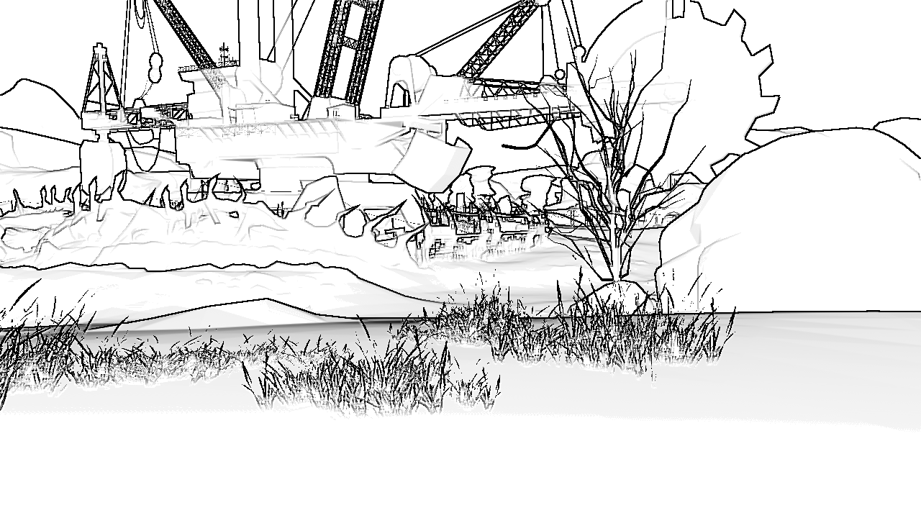
Black Outlines. Improved Sobel Filter - Raw Filter

Slide 55
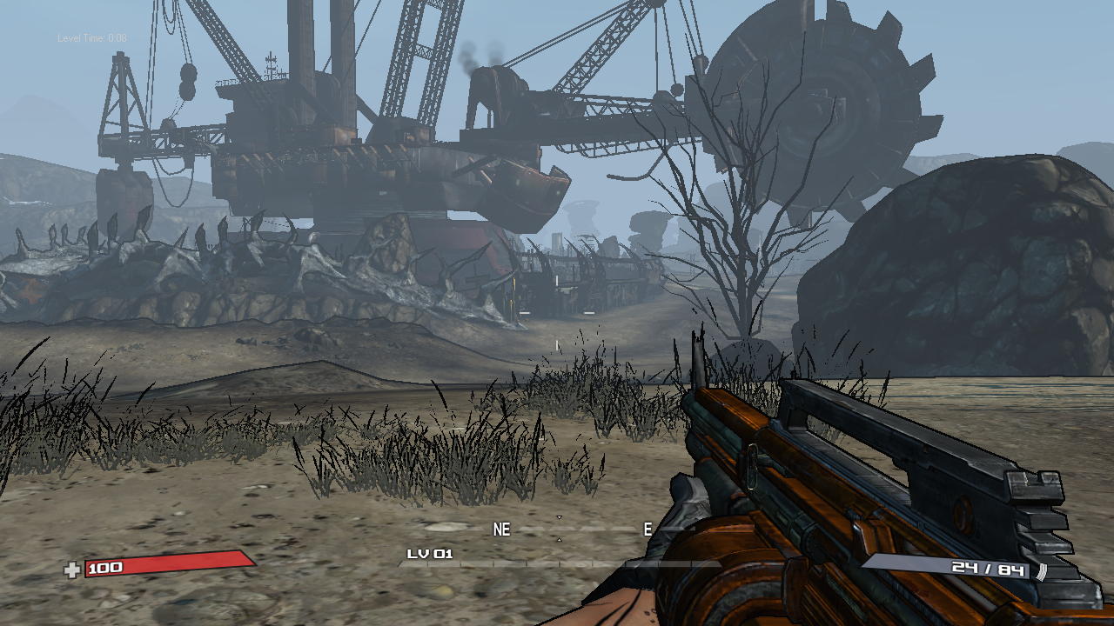
Black Outlines. Improved Sobel Filter - Composite

Slide 56
Final Sobel Filter
Good News:
We shipped this
Bad News:
Each platform (PC, X360, PS3) has a different pipeline
Could not compute all the edges we wanted

Slide 57
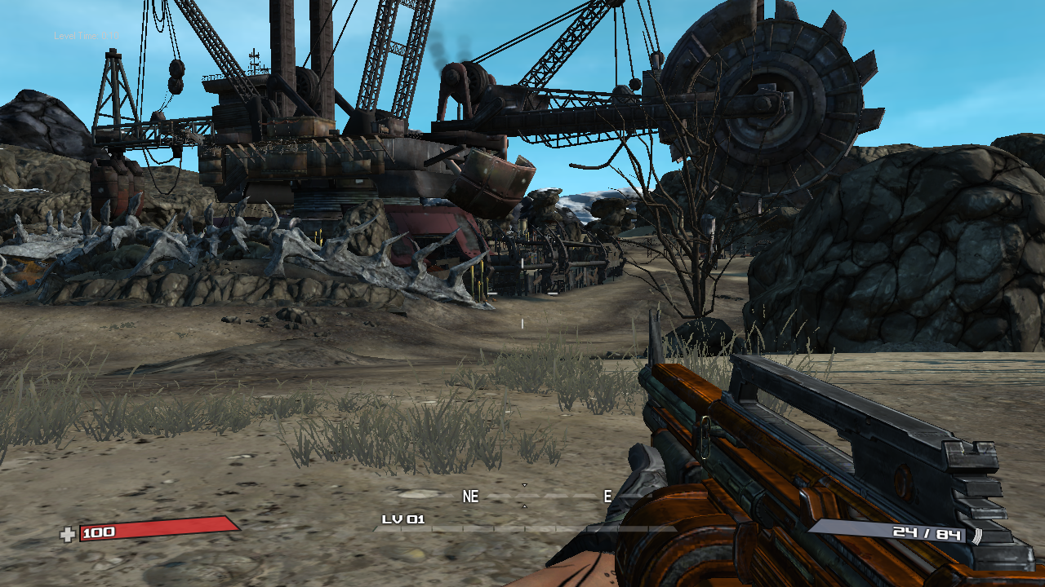
Black Outlines. Recap – Without any Processing

Slide 58
Black Outlines. Recap – Final Composite

Slide 59
Emergent Problems
Black Outlines are dependant on depth precision and range
Postprocess Screen Effects affected outlines
Foliage is still ugly
Resolution Dependant
Could not get all the edges we wanted
Black Outlines. Emergent Problems

Slide 60
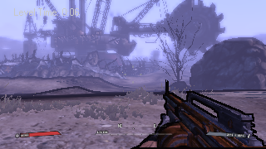

Resolution Dependant (we did not solve this)
320x180
1280x720
Black Outlines. Resolution Dependant

Slide 61
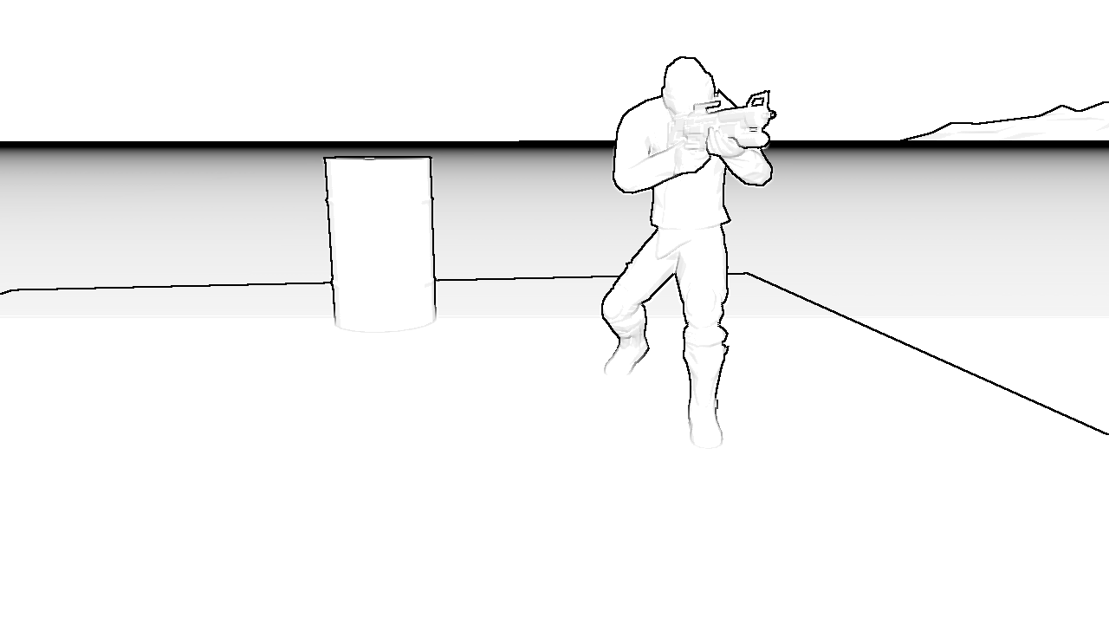
Black Outlines. Lines we could not get

Slide 62
Fixing the Foliage
Mask out the foliage with a stencil test
Set per-material property to control the stencil value so artists can control what has edges
Required foliage be masked and not alpha-blended
Black Outlines. Foliage Problem

Slide 63
Black Outlines. Foliage Problem

Slide 64
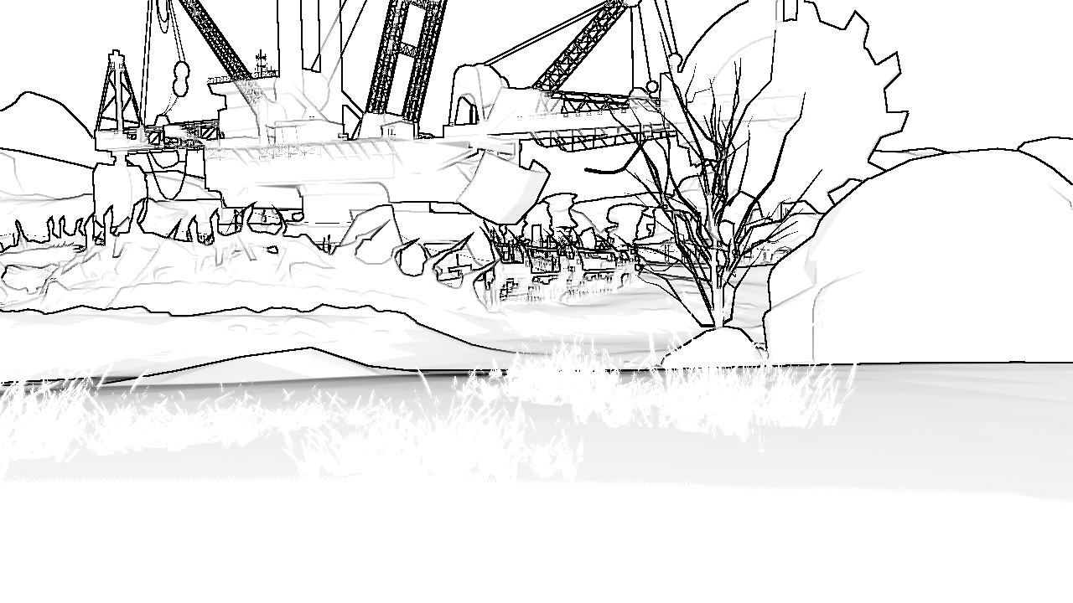
Black Outlines. Foliage Problem – Stencil Masked

Slide 65
Depth Precision
Game outputs W to the alpha channel of our frame buffer
W Values originally ranged from 10..65504 only use 12.5 of the 30 available exponents and do not use the sign bit
Wastes 80% of the range!
Our max viewable distance is much larger than 65504 units
Fixed it all with a new W encoding
Black Outlines. Depth Precision

Slide 66
Encoding Depth Intelligently
Looked at shader instruction set:
Tried exp2, log2 encoding
Plotted distribution of values in Excel
Made things worse!
Found a better solution:
square W on write to FP16
sqrt on read from FP16
Scale W before output so full 0..65504 range is used
Use two scales, near and far
Use the sign bit to select the right scale
Black Outlines. Depth Precision

Slide 67
Gearbox Scene FP16 W Encoding
half EncodeFloatW(float W)
{
float Distance = float(W);
float Value;
if (W > 4096)
{
Value = (float)Distance / 8192;
Value = Value * Value;
Value = clamp(Value, 0, 65503);
}
else
{
Value = (float)Distance / 32;
Value = Value * Value;
Value = -Value;
Value = clamp(Value, -65503, 0);
}
return Value;
}

Slide 68
Gearbox Scene FP16 W Decoding
float DecodeFloatW(half W)
{
float FloatW = abs(W);
float Value;
if (W > 0)
{
Value = ((float)sqrt(FloatW)) * 8192;
}
else
{
Value = ((float)sqrt(FloatW)) * 32;
}
return Value;
}

Slide 69
FP16 W Encoding
Excellent distribution of values
Overhead is minimal but not free
Max view distance with these coefficients is 2097152 units instead of 65504
The number 65503 is in the shader due to older GPUs turning 65504 into NaNs
Less banding in depth effects (Fog, Depth of Field)
Precision is very suitable for Deferred Shading
Black Outlines. Depth Precision

Slide 70
Using Research at Gearbox
We favor older research (5-10+ years)
Usually much faster
Older techniques frequently have more approximations available or have been put into hardware
We try the most likely technique that will work for our current problem, and stop searching once we find something suitable
Black Outlines. Old Stuff

Slide 71
Using Research at Gearbox
New research is scary (<5 years)
Most topics are not applicable for real-time use
Many of the remaining topics are slow on cutting edge hardware
3 ms is our comfort zone for a single feature
Most of what’s left still does not usually solve integrating with a complex rendering pipeline
Black Outlines. New Stuff

Slide 72
Final Product
Final Push. October 2008 – October 2009

Slide 73
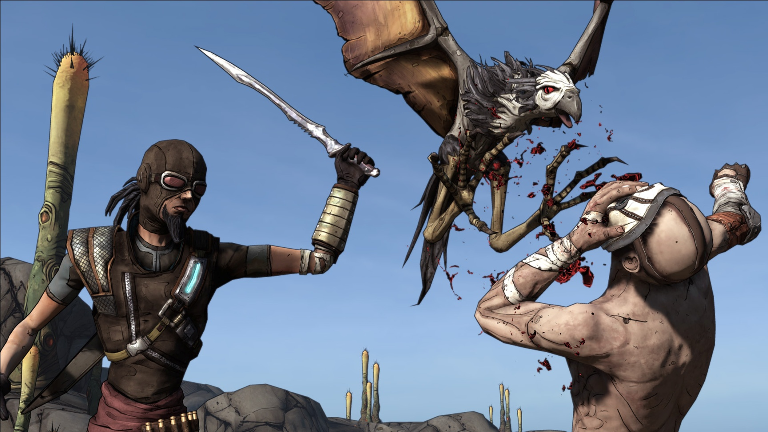
Final Push. October 2008 – October 2009

Slide 74
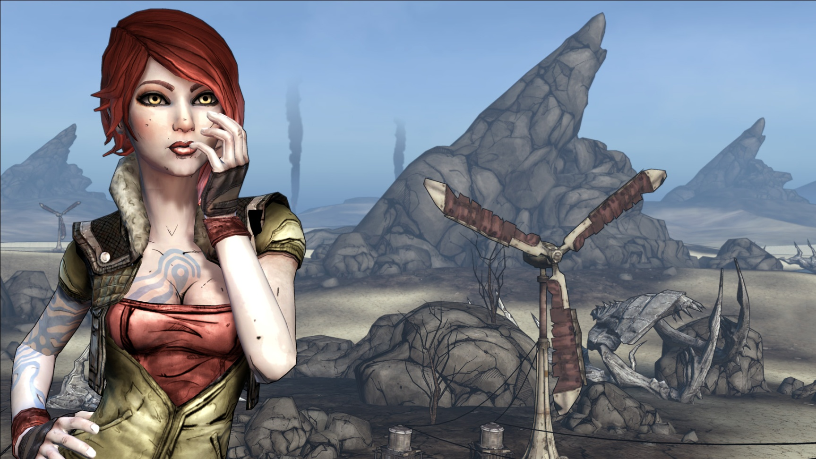

Slide 75


Slide 76


Slide 77


Slide 78



Slide 79




Slide 80

Presentation Collaborators
David Ziman
Brian Burleson
Brian Cozzens
Sobel Filter Reference: Sobel, I., Feldman,G., "A 3x3 Isotropic Gradient Operator for Image Processing", presented at a talk at the Stanford Artificial Project in 1968, unpublished, orig. in Pattern Classification and Scene Analysis, Duda,R. and Hart,P., John Wiley and Sons,'73, pp271-2
Special Thanks.

